Slide 1
School of Law Orientation 2023/2024

Slide 2
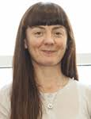
Welcome to the School of Law!
Éilis O’Regan Acting Director of Strategic Development and Administration

Slide 3
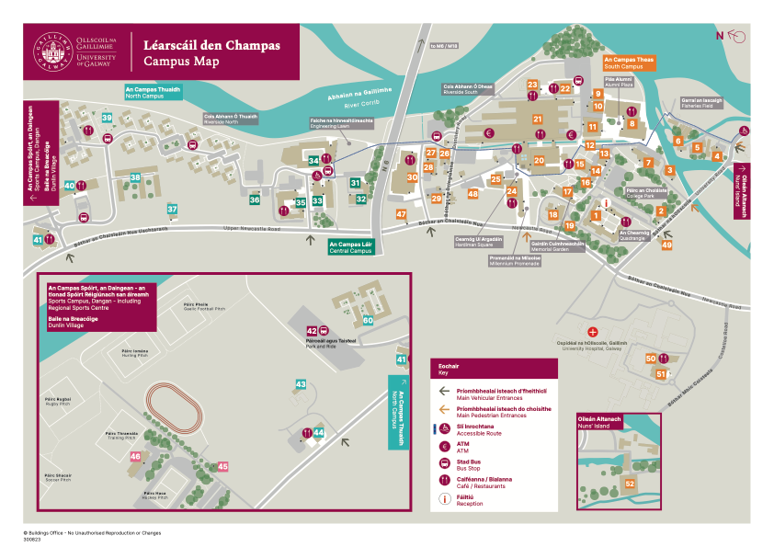
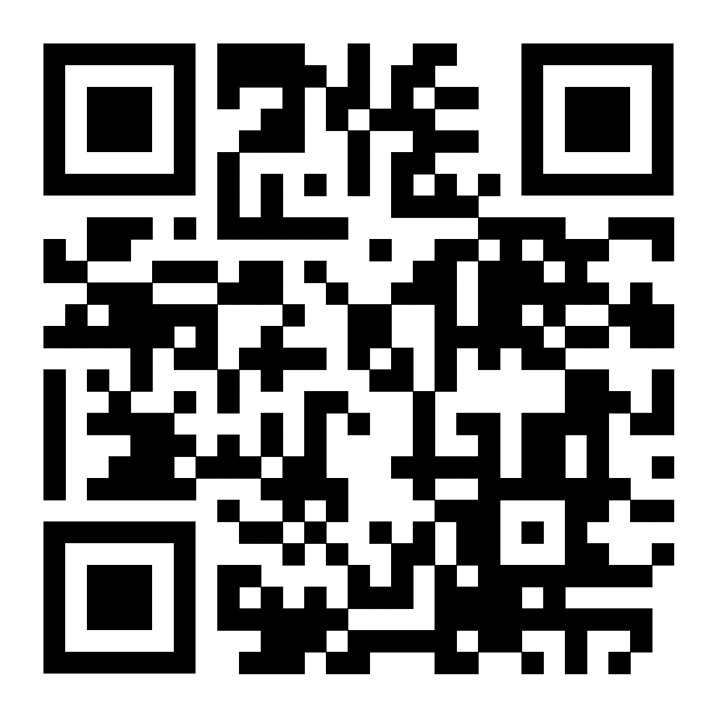
School of Law Office ​
Where to find us:
Room 406, Floor 2, Tower 2, Concourse (Arts/Science Building)
Take the lift outside this lecture theatre to the second floor
Bookmark this interactive map from the Buildings Office:

Slide 4
The School of Law Office
Query Type | Who to Contact
Module Specific Queries | Ask your lecturer (module outlines available via module Canvas page)
Timetables (changes notified via e-mail and online version updated) | https://www.universityofgalway.ie/law/students/timetables/
General Queries (Deferrals, Leave of Absence, Medical Queries, Transfers) | School Office: In-person – Room 406, Floor 2, Tower 2, Concourse (Arts/Science Building) By email - law@universityofgalway.ie
Advice and Guidance for Students | AnnMarie Gilchrist, Student Support Officer - annmarie.gilchrist@universityofgalway.ie
Academic Queries | Check your Academic Booklet for guidance: https://www.universityofgalway.ie/law/students/startofterm/

Slide 5
Later this Afternoon: Language Options
Full information at 2.30pm in AC201 (down the corridor from this theatre)
Meet the Language lecturers informally
Gaeilge - Máire Treasa Uí Shúilleabháin
Spanish - Begona Sangrador-Vegas
French - Máire Aine Ní Mhainnín
German - Deirdre Byrnes

Slide 6
Later this Afternoon: Treasure Hunt
Meet at the table with the Law banner outside this theatre at 3pm
Join/get divided into teams of 4
Don’t know anyone? Say hello to the person on your left and right and look out for them later ☺
First team to visit all the locations (and take a photo for Instagram) wins University of Galway hoodies

Slide 7
Library Orientation 2023

Slide 8
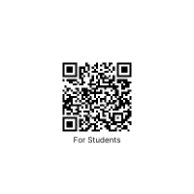
Welcome Students
Welcome Desk located in the Library Foyer, staff will answer any general questions you may have
Get Connected desk located in the Library Foyer, staff will help you connect to University systems
Library Tours: in person tours are available during September **
VR Library Tours: go online and take a VR tour or visit the MakerSpace and take a tour using a VR headset
Introductory workshops: check online for details of workshops to help you get started with Assignments
Click on the QR code for more information on the above

Slide 9
Law Student Introduction/Tours
Tuesday 26th September: Meet in Library foyer at 2pm
Short introductory talk
Small group tours

Slide 10
General Tips

Slide 11
Module Registration
Students must register online and select optional modules by deadline of 29th September 2023 (advisable to complete registration ASAP so you can access the relevant module information via Canvas)
https://www.universityofgalway.ie/registration/
YOU WILL NOT BE PERMITTED TO CHANGE YOUR MIND AFTER THIS DATE

Slide 12
Things to remember
Use your University of Galway email address
Regularly check your student email account
All module content will be posted on Canvas pages, specific to each module
All programme-related content will be posted on your course instance Canvas page

Slide 13
Emails
Put the programme code in the email subject line e.g. 1BCL1
Use your student email address
Sign with full name, student ID number and programme code e.g. Mary Smyth, 23428561, 1BCL1
Address the email appropriately (Dear/Hi)
Introduce yourself
Use proper spelling

Slide 14
Student Supports
https://www.universityofgalway.ie/student-life/student-support/

Slide 15
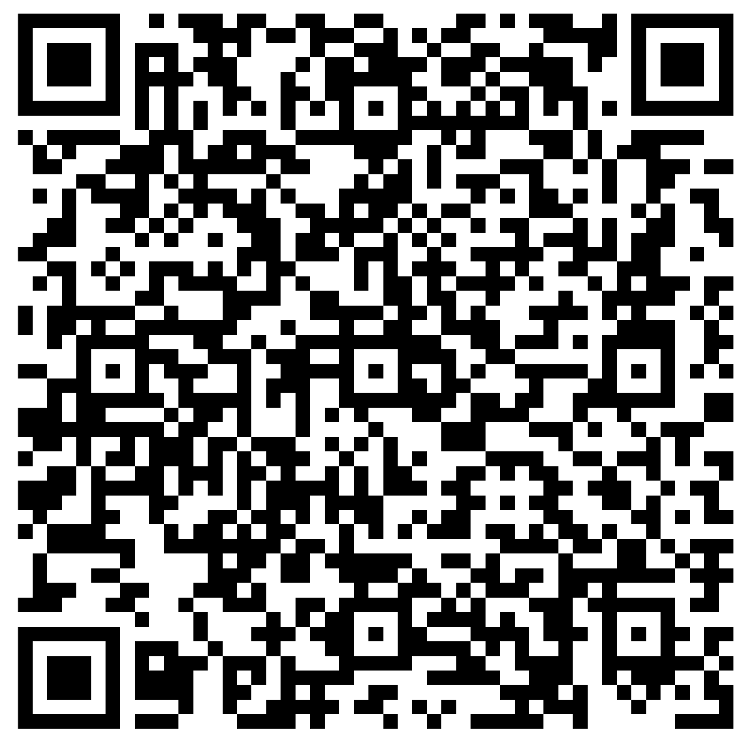
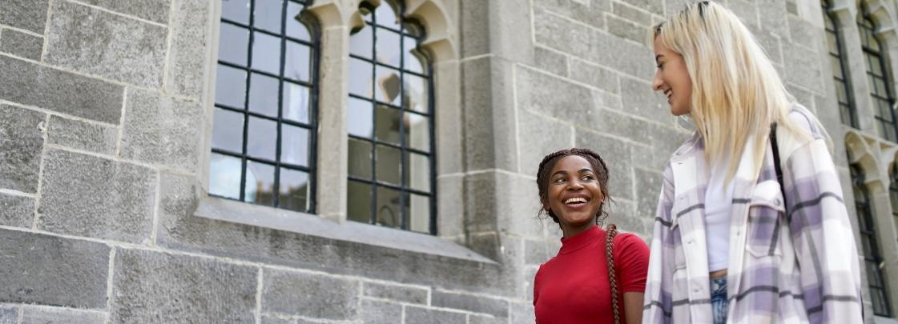
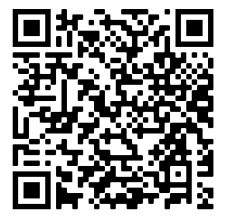
Get University Ready!
On campus Orientation Timetable Friday Sept 15
School of Law
Notes:
Slide for inclusion at online events to help student prepare for on campus orientation. Can also be used at on campus events particularly those on Friday morning.
Prearrival module, Tus Maith https://rise.articulate.com/share/1lISC-ugIiutgIXgY2JIhsQIxuqs0wng#/ has valuable information on the university, systems ID cards, intro to Student Advisers etc. Recommended to complete this before coming on campus. The Help Hub answers questions about Parking, Parents/Guardians space, supports on campus as well as info on campus tours etc. QR code to timetable to help plan the day, location for talks, events etc.

Slide 16
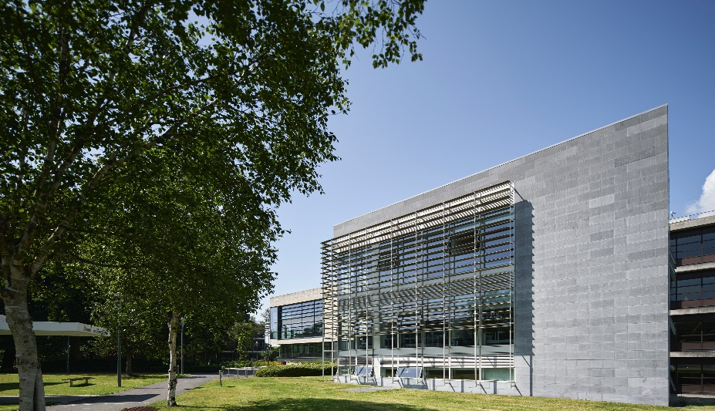
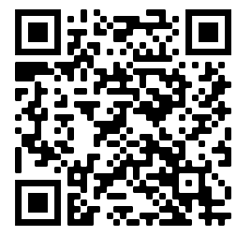
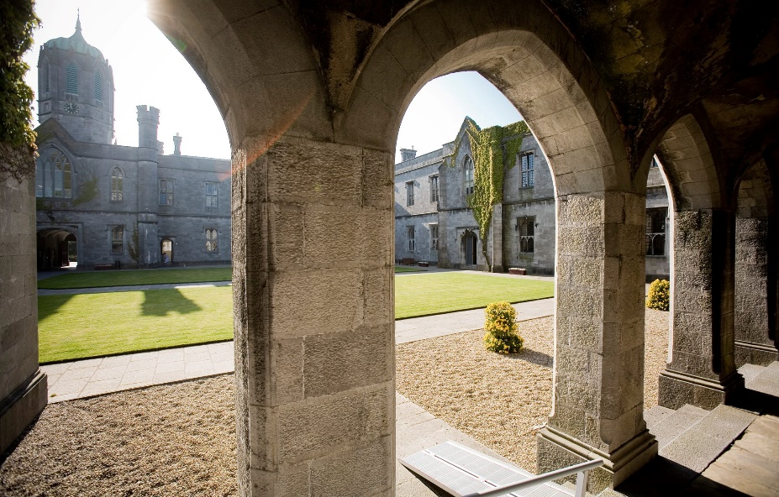
Get Connected Help Desk
Library, 10am–4pm Friday & 10am-12pm Saturday
Class of 2023 photo – all first years
4.15pm, today Fri 15 Sept
Quadrangle
Student Life 101 – Mandatory Session
12pm, Sat 16 Sept
followed by Student Life Expo
Bailey Allen Hall, Áras na MacLeinn
Campus Tours
Friday and Saturday 9am – 4pm
Every 30 mins from Quadrangle
Notes:
Freshers Fest on Friday and Saturday is optional with events to suit every taste. Encourage all to join the class photo. One mandatory event for each College on Saturday morning. Also promote the Campus tours starting from the Quad and Get Connected desk in the Library for anyone struggling with canvas, email, wifi, etc.

Slide 17
Notes:
Student Services will be in contact with more information, handy guides etc during each of these themed weeks

Slide 18
Thank you for listening
Any questions?
Next Session: Meet the Programme Directors and learn about the LW3120 ‘Understanding the Law’ module
Then 11.30 am in the Sports Centre, Kingfisher

